Slide 1
ENVIRONMENTAL IMPACT OF FOOD PRODUCTION
ANALYSIS
Compiled By: Selorm Etse-Forfoe

Slide 2
Goal
To assess the environmental impact of food production at both macro and micro levels and propose data-driven insights to mitigate the negative effects of food production on the environment.
2

Slide 3
The CRISP-DM Framework
Develop business problem and analytical questions.
Understand data and preprocess data.
Develop visualizations to communicate insights to business questions.
Provide comprehensive conclusions with actionable solutions from the analysis conducted.
3

Slide 4
Business and Analytical Questions
Which foods contribute the most to greenhouse gas (CO₂ equivalent) emissions, and at which stages (land use, farm, processing, transport, packaging, retail)?
Which foods have the highest water footprint, and how does this correlate with their carbon footprint?
What is the relationship between food types and land use change emissions?
At which stage of the food lifecycle do emissions peak for most food products?
Can we rank foods from “most sustainable” to “least sustainable” based on combined emissions, water, and land use?
How do animal-based products compare to plant-based products in terms of overall environmental footprint?
4

Slide 5
Dataset Preparation
1 Dataset (43 records, 23 parameters)
Conventionalized column names by replacing spaces with underscores “_”.
Filled null values with median or mean depending on skewness:
High skewness - median
Low skewness - mean
Rounded all float values to 2 decimal places.
5

Slide 6
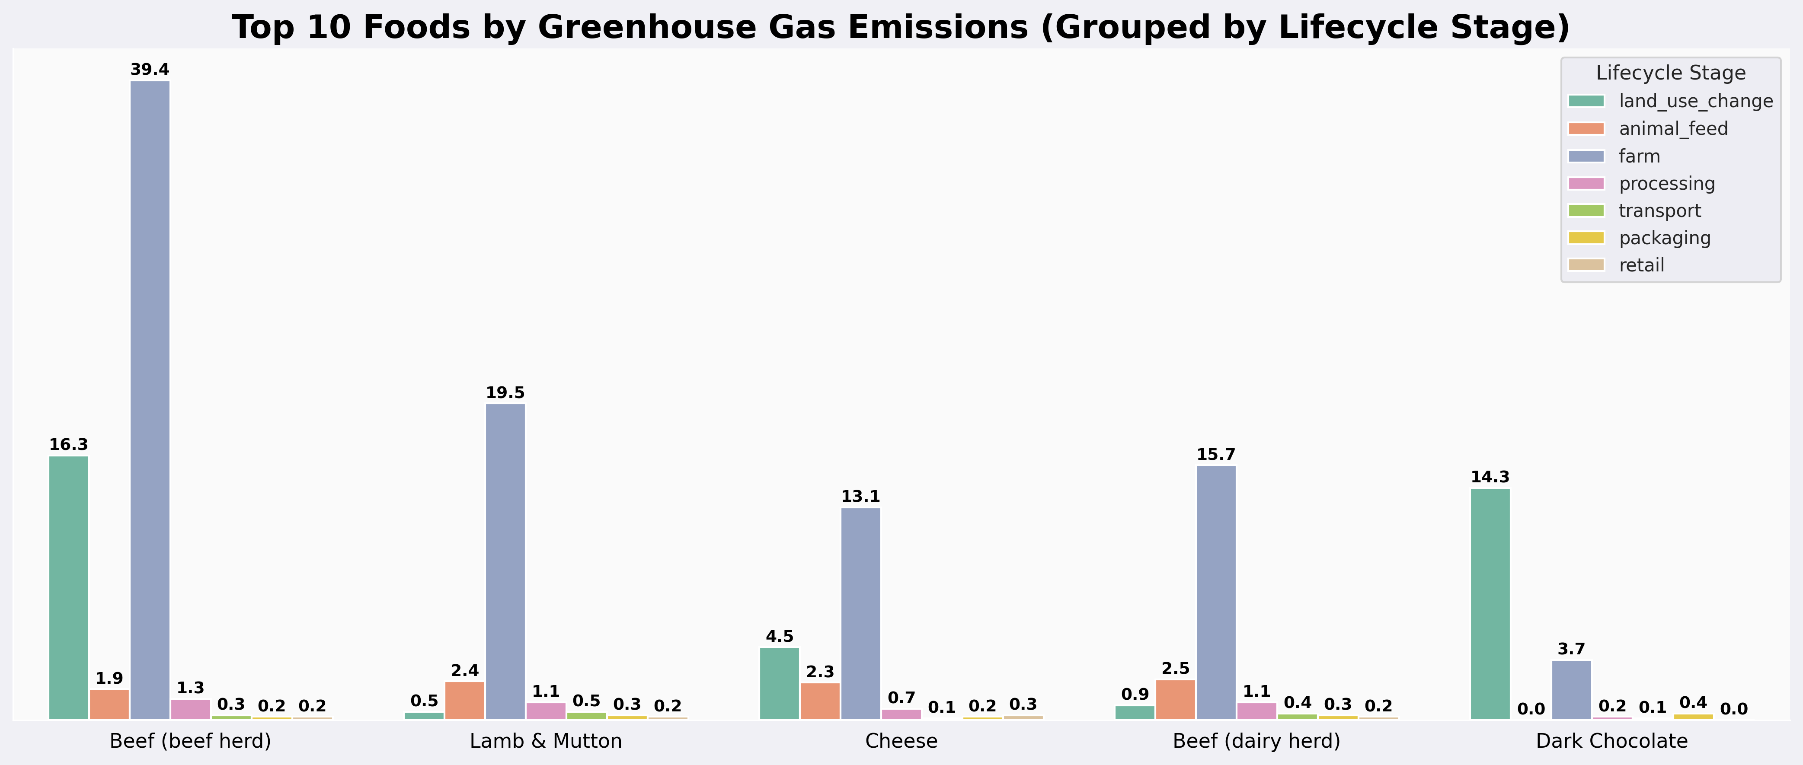
1. Which foods contribute the most to greenhouse gas emissions, and at which stages (land use, farm, processing, transport, packaging, retail)?
Greenhouse gas emissions are overwhelmingly driven by farm-stage activities and land use change, especially for livestock-based foods.
Targeting agricultural practices and land management will potentially reduce emissions.
6

Slide 7
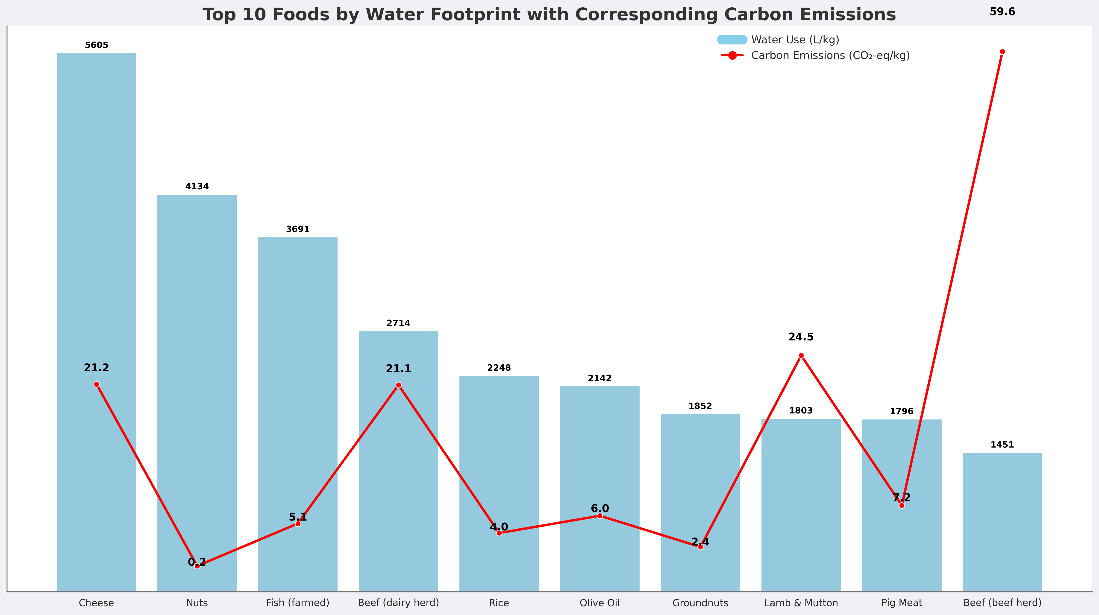
2. Which foods have the highest water footprint, and how does this correlate with their carbon footprint?
Water footprint and carbon emissions show only a moderate correlation (0.33)
One metric alone doesn’t capture full environmental impact.
7

Slide 8
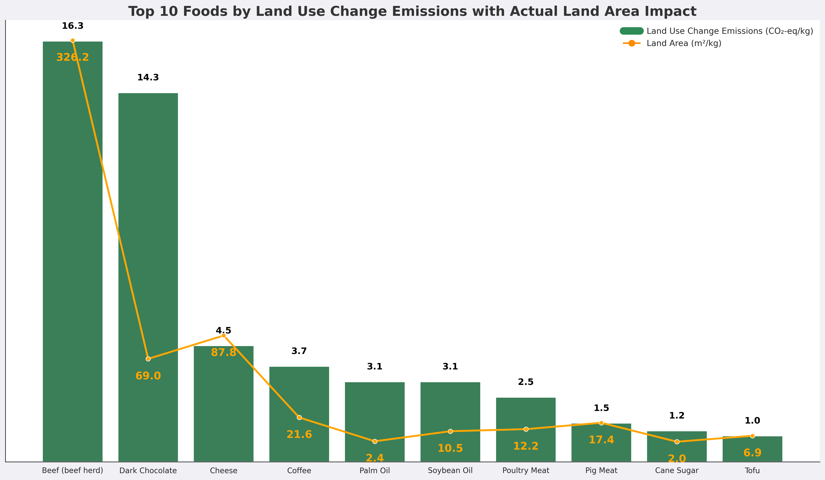
3. What is the relationship between food types and land use change emissions?
Beef and dark chocolate exert disproportionately high land use emissions, making them critical targets for sustainable interventions.
Shifting consumption towards plant-based, low-footprint foods can significantly reduce pressure on land resources.
8

Slide 9
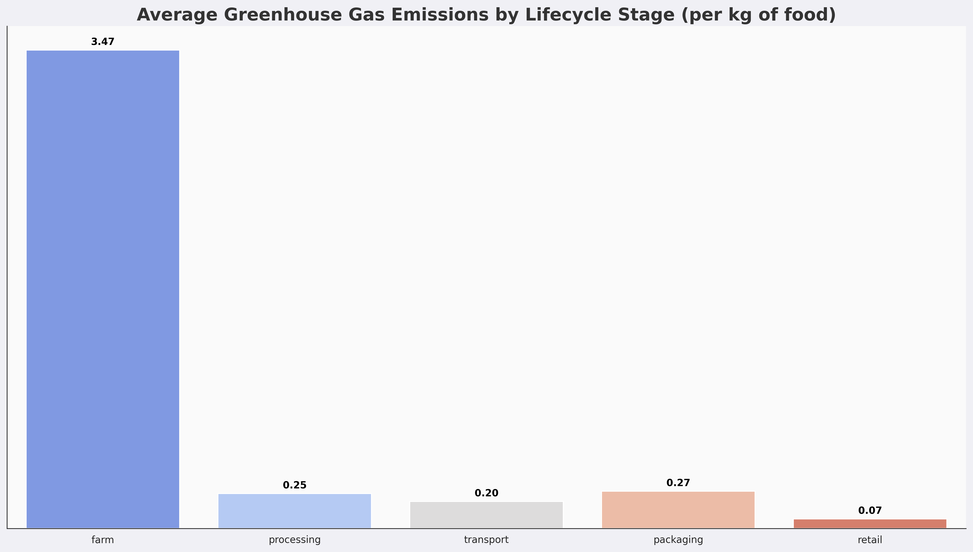
4. At which stage of the food lifecycle do emissions peak for most food products?
Over 80% of food-related emissions occur at the farm stage, making it the critical focus for sustainability interventions.
Downstream stages like transport, packaging, and retail have minimal overall impact compared to agriculture.
9

Slide 10
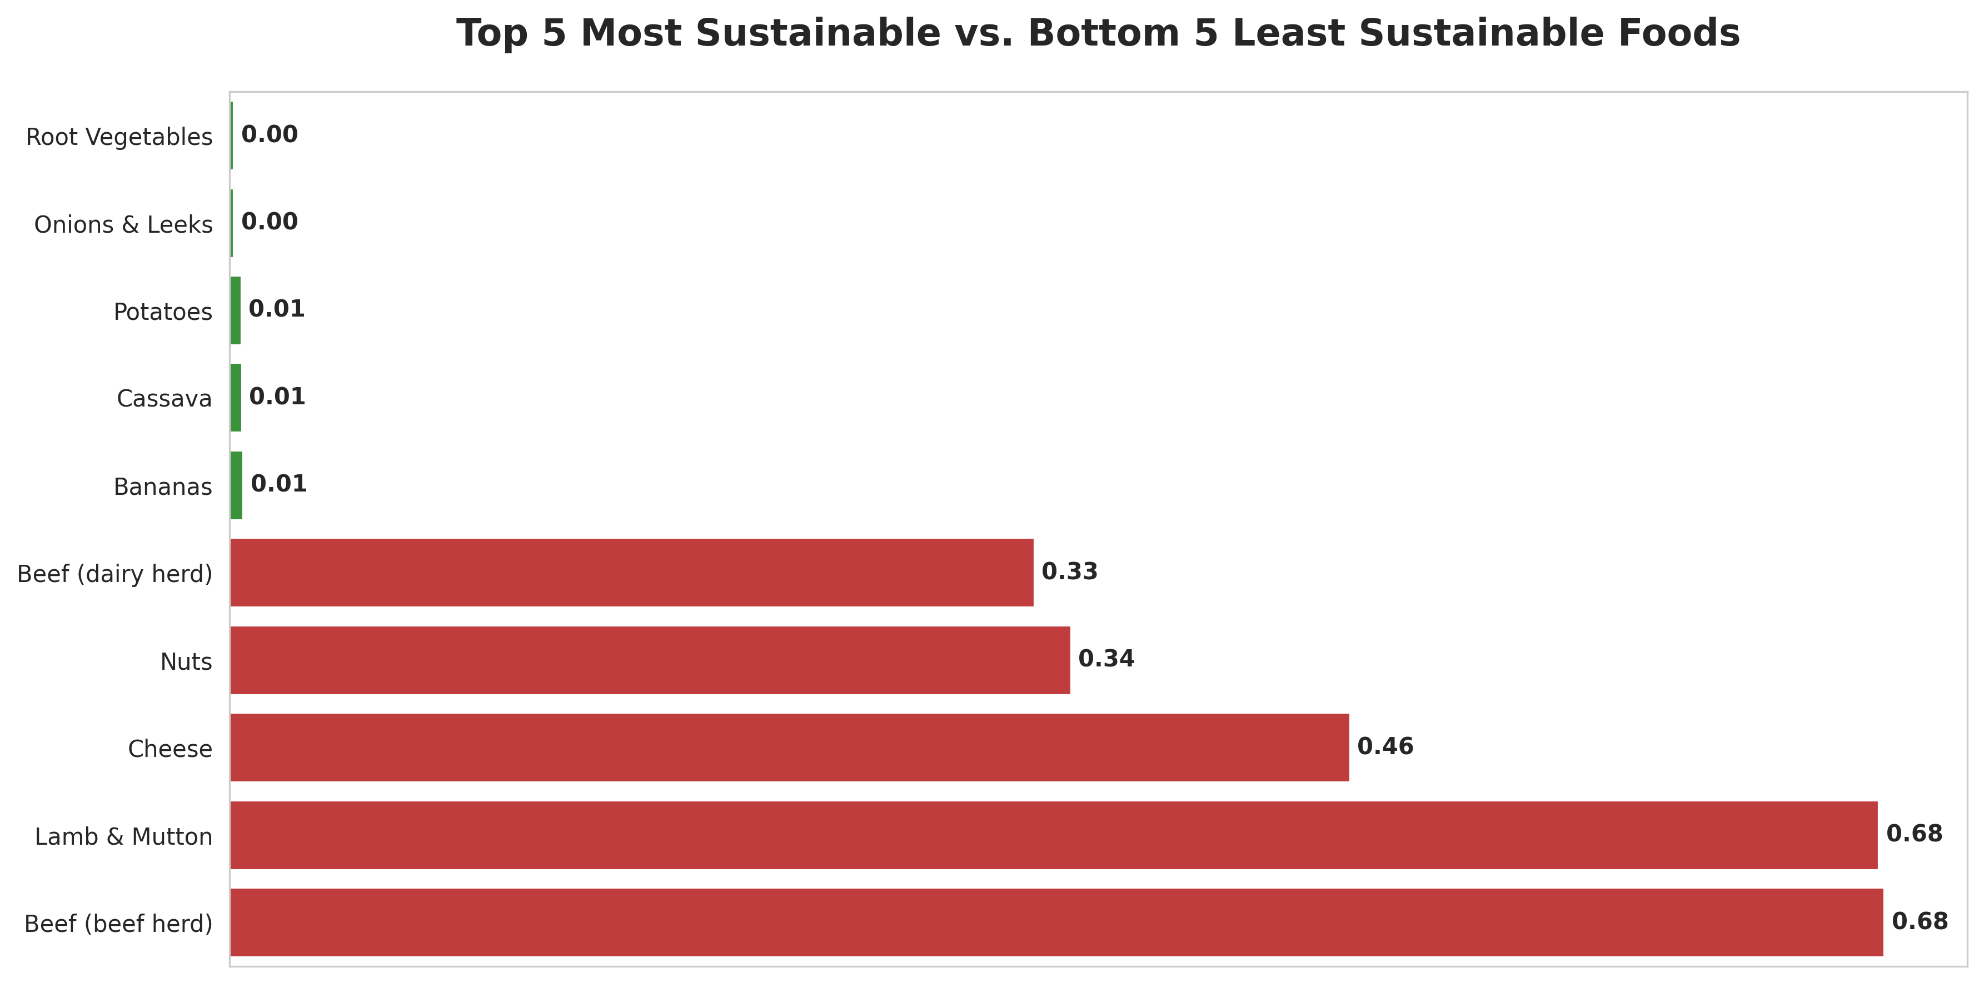
5. Rank foods from “most sustainable” to “least sustainable” based on combined emissions, water, and land use?
Plant-based foods are consistently more sustainable.
Beef, lamb, and dairy products are environmental hotspots.
10

Slide 11
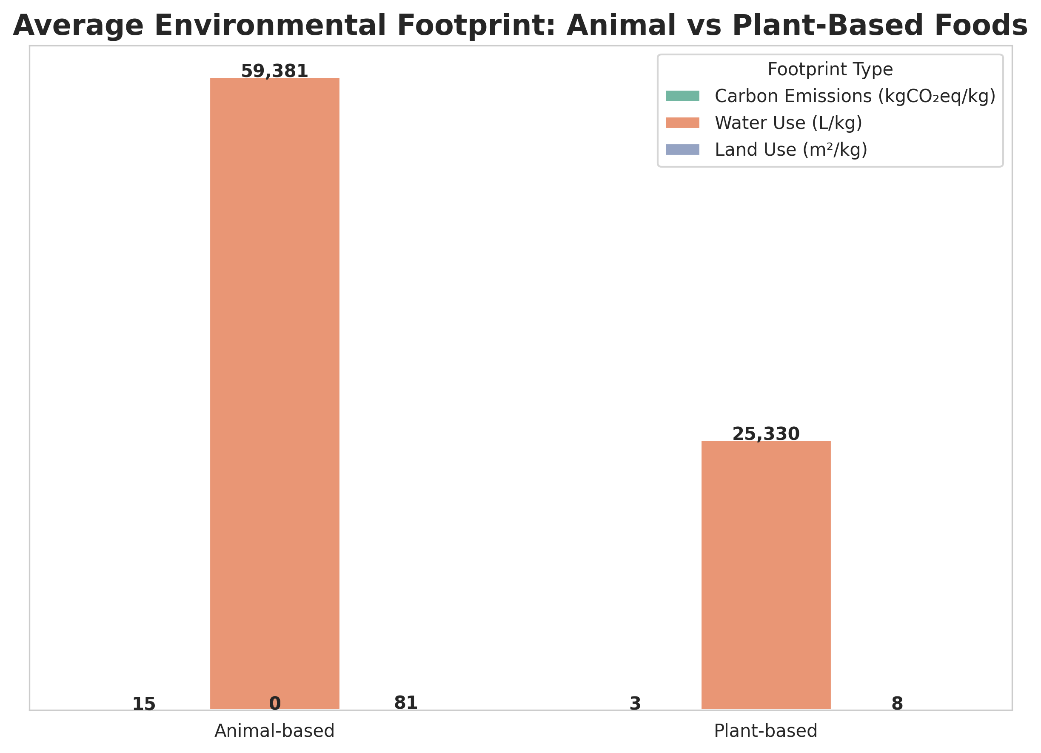
6. How do animal-based products compare to plant-based products in terms of overall environmental footprint?
Animal-based foods have more than double the environmental footprint of plant-based foods.
Shifting towards plant-based diets can meaningfully reduce overall resource use and emissions.
11

Slide 12
General Insights and Conclusions
Livestock production (Animal-based products) dominates environmental impact — Beef, Lamb, and Dairy are leading contributors.
Farm-stage activities are the primary emissions hotspot — Over 80% of total emissions occur during the farm stage.
Trade-offs exist between environmental metrics (carbon, water, land) — Foods like cheese and nuts have high water footprints but relatively lower emissions.
Plant-based foods consistently show sustainability advantages.
A small number of foods drive a disproportionate share of impact.
Large disparity between animal and plant-based products highlights likely resource inefficiencies in livestock production (feed conversion ratios, methane emissions, and land clearing).
12

Slide 13
Recommendations
Promote plant-based diets and alternative proteins
Focus on farm-level emissions reduction - precision agriculture, methane-reducing feed additives, better manure management, and regenerative farming practices.
Target high-impact foods for intervention: Prioritize reducing consumption and production of beef, lamb, dairy, and other disproportionately impactful foods through education, labeling, and pricing strategies.
Encourage water-efficient farming (drip irrigation, drought-resistant crop varieties, better water governance)
Limit deforestation, incentivize sustainable land management, and invest in afforestation to address land use change emissions.
Support research into sustainable farming technologies, carbon capture in agriculture, and climate-smart livestock systems.
Consumer awareness and policy alignment (clear product labeling, awareness campaigns, and sustainability standards).
13

Slide 14
Relevant Resources
GitHub Repository
https://github.com/dspselorm/Evironmental_Impact_of_Food_Production_Analysis
14

Slide 15
THANK YOU!
15

